Slide 1

CNCF Cross-cloud CI Project Intro
Taylor Carpenter & Denver Williams, Vulk.coop
Notes:
Tuesday December 11, 2018
2:35pm - 3:10pm
2 A/B

Slide 2

Project Intro
CNCF Cross-Cloud CI tests Kubernetes (K8s) and projects running on K8s across multiple cloud providers.
Notes:
https://github.com/crosscloudci/crosscloudci

Slide 3
Project Intro - 35 minutes
History of the Project
Why and What
Project Overview
Technology Overview
Lessons Learned
What’s Next
Q&A
Notes:
https://github.com/crosscloudci/crosscloudci

Slide 4
Cross-cloud CI Intro: History
History and why the project exists:
The project started from as an idea in early 2016 to test the compatibility of Kubernetes versions on cloud providers along with applications running on those clusters.
This was before the K8s Conformance Group, Cluster API project and well before a GA version of kubeadm existed. At that time there were very few cloud providers offering K8s as a service, such as Google Kubernetes Engine (GKE).

Slide 5
Cross-cloud CI Intro: What is it?
What? The Cross-cloud CI project consists of a composable base CI system, a status repository server and a dashboard.
The underlying CI testing system has 3 components (build pipeline, multi-cloud provisioner cross-cloud, cross-project) that continually validate the interoperability of each CNCF project for any commit on stable and head across all supported cloud providers.
The testing system can reuse artifacts from a project’s existing CI system or generate new build artifacts. The status repository server collects the test results and the dashboard displays them.
Notes:
https://github.com/crosscloudci/crosscloudci#what-is-cross-cloud-ci

Slide 6
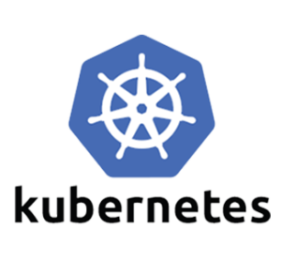

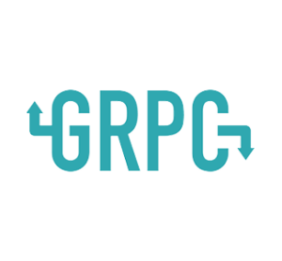
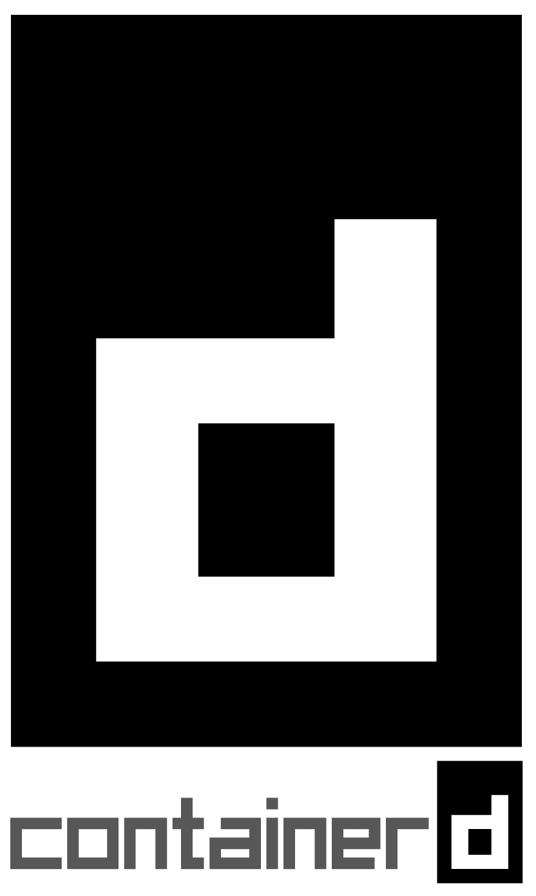

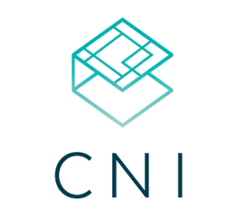


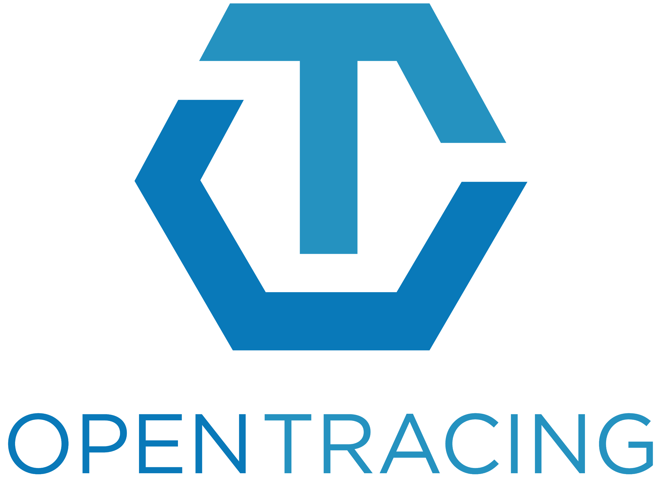

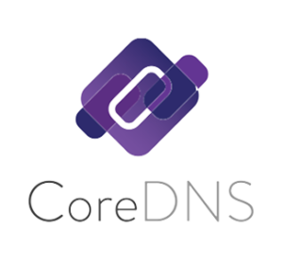
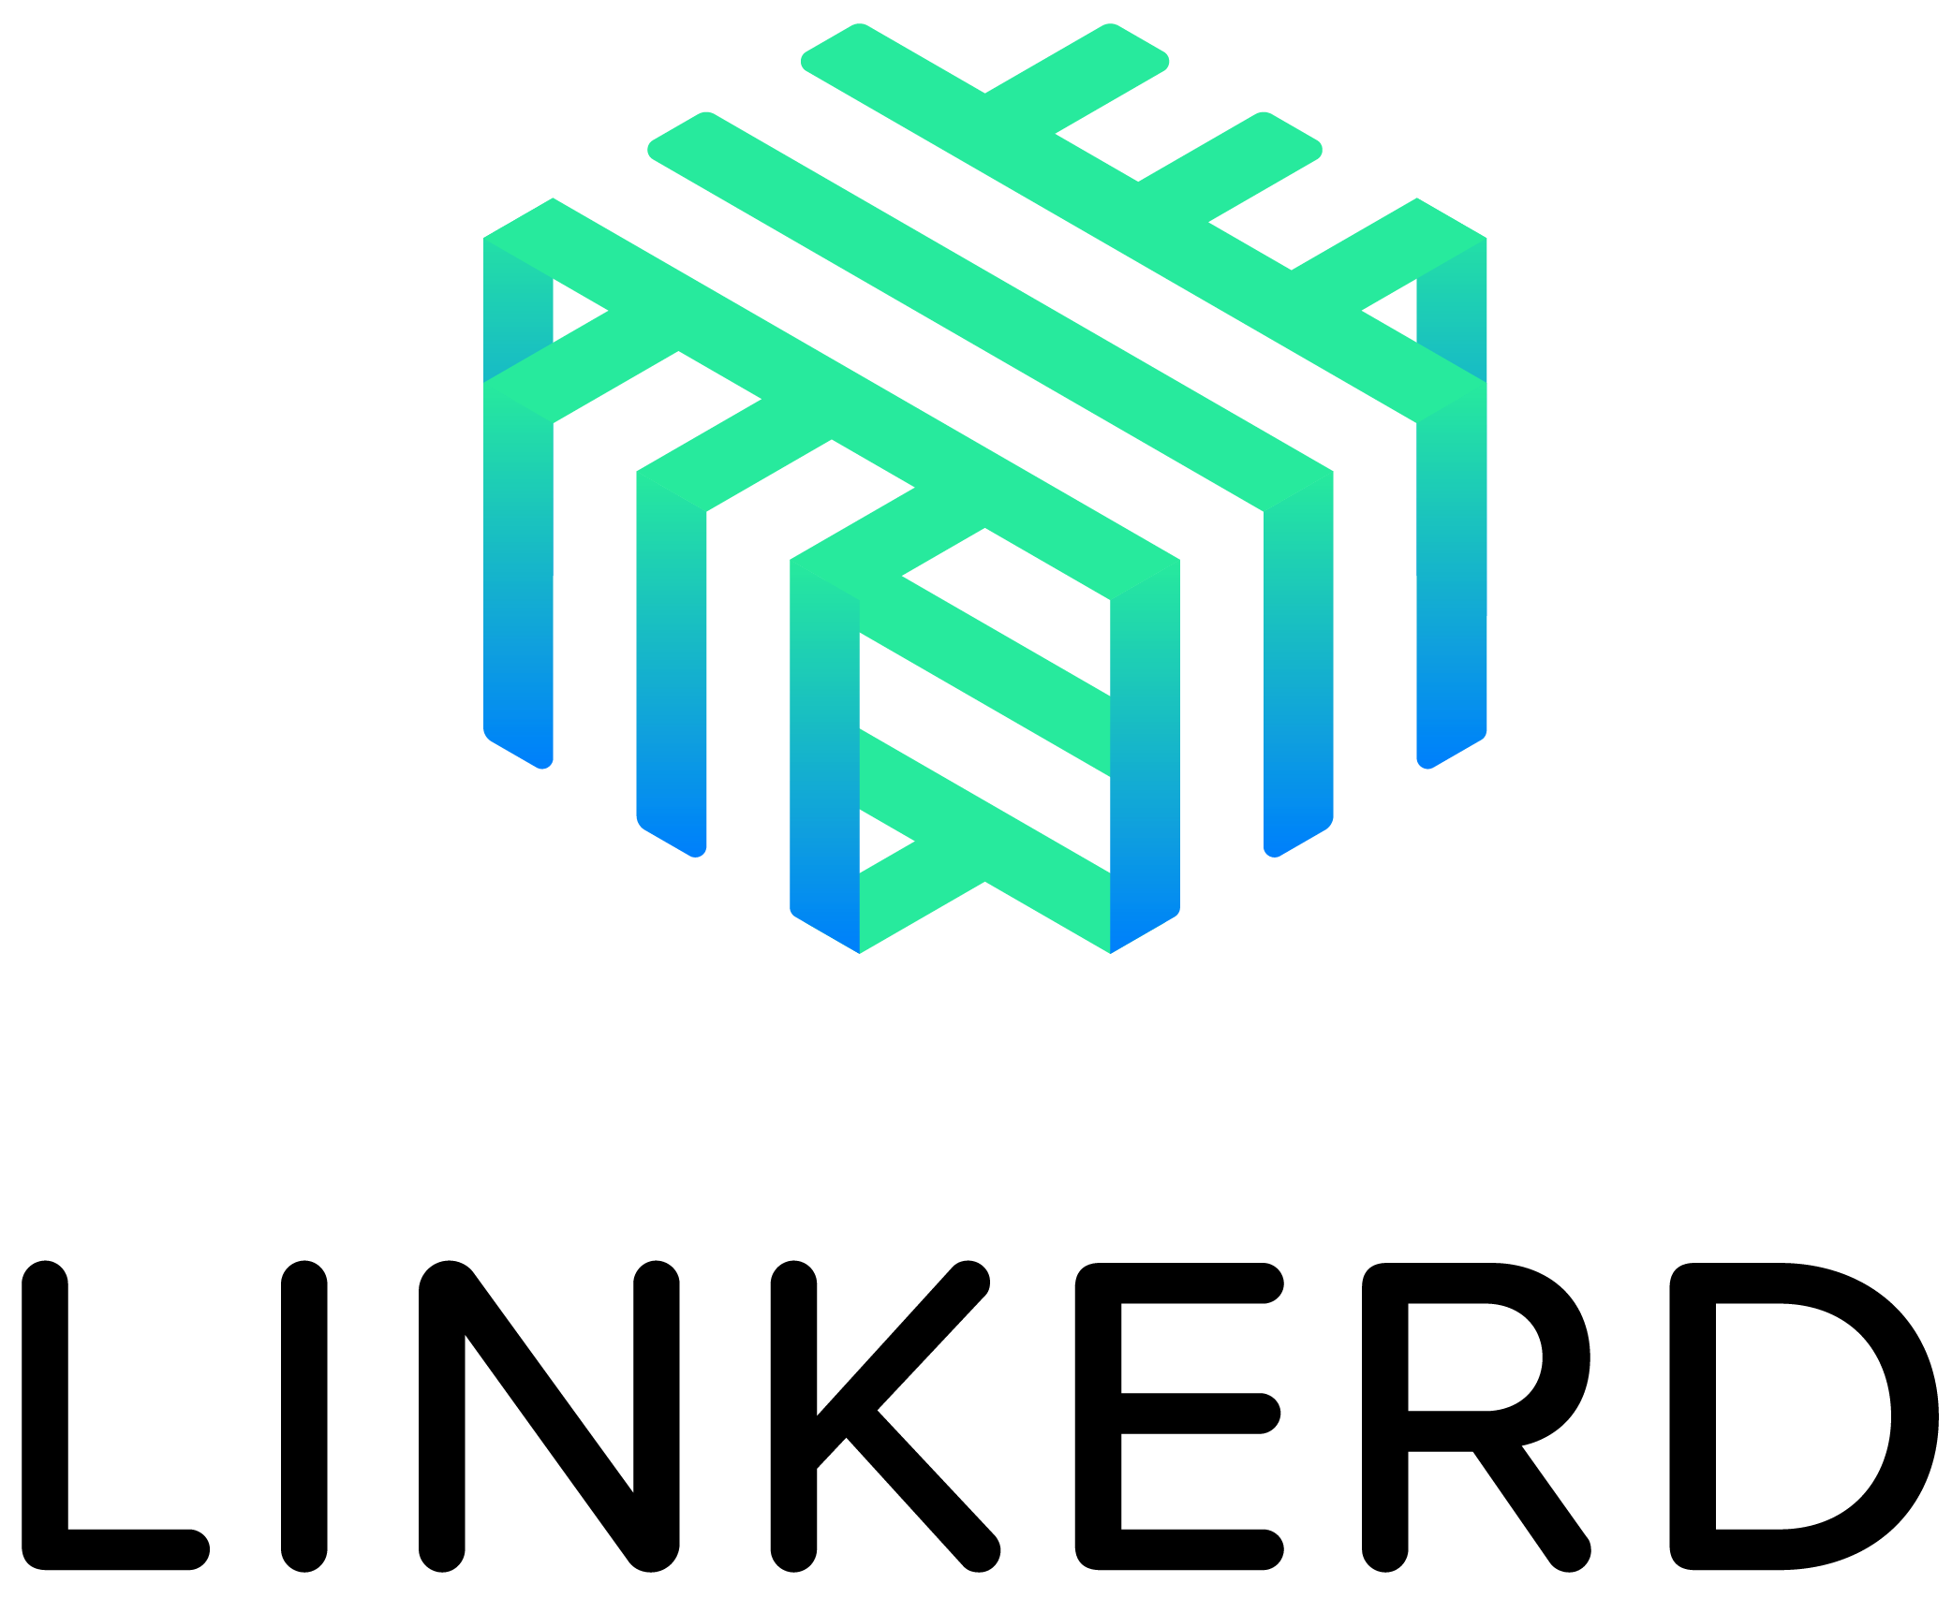


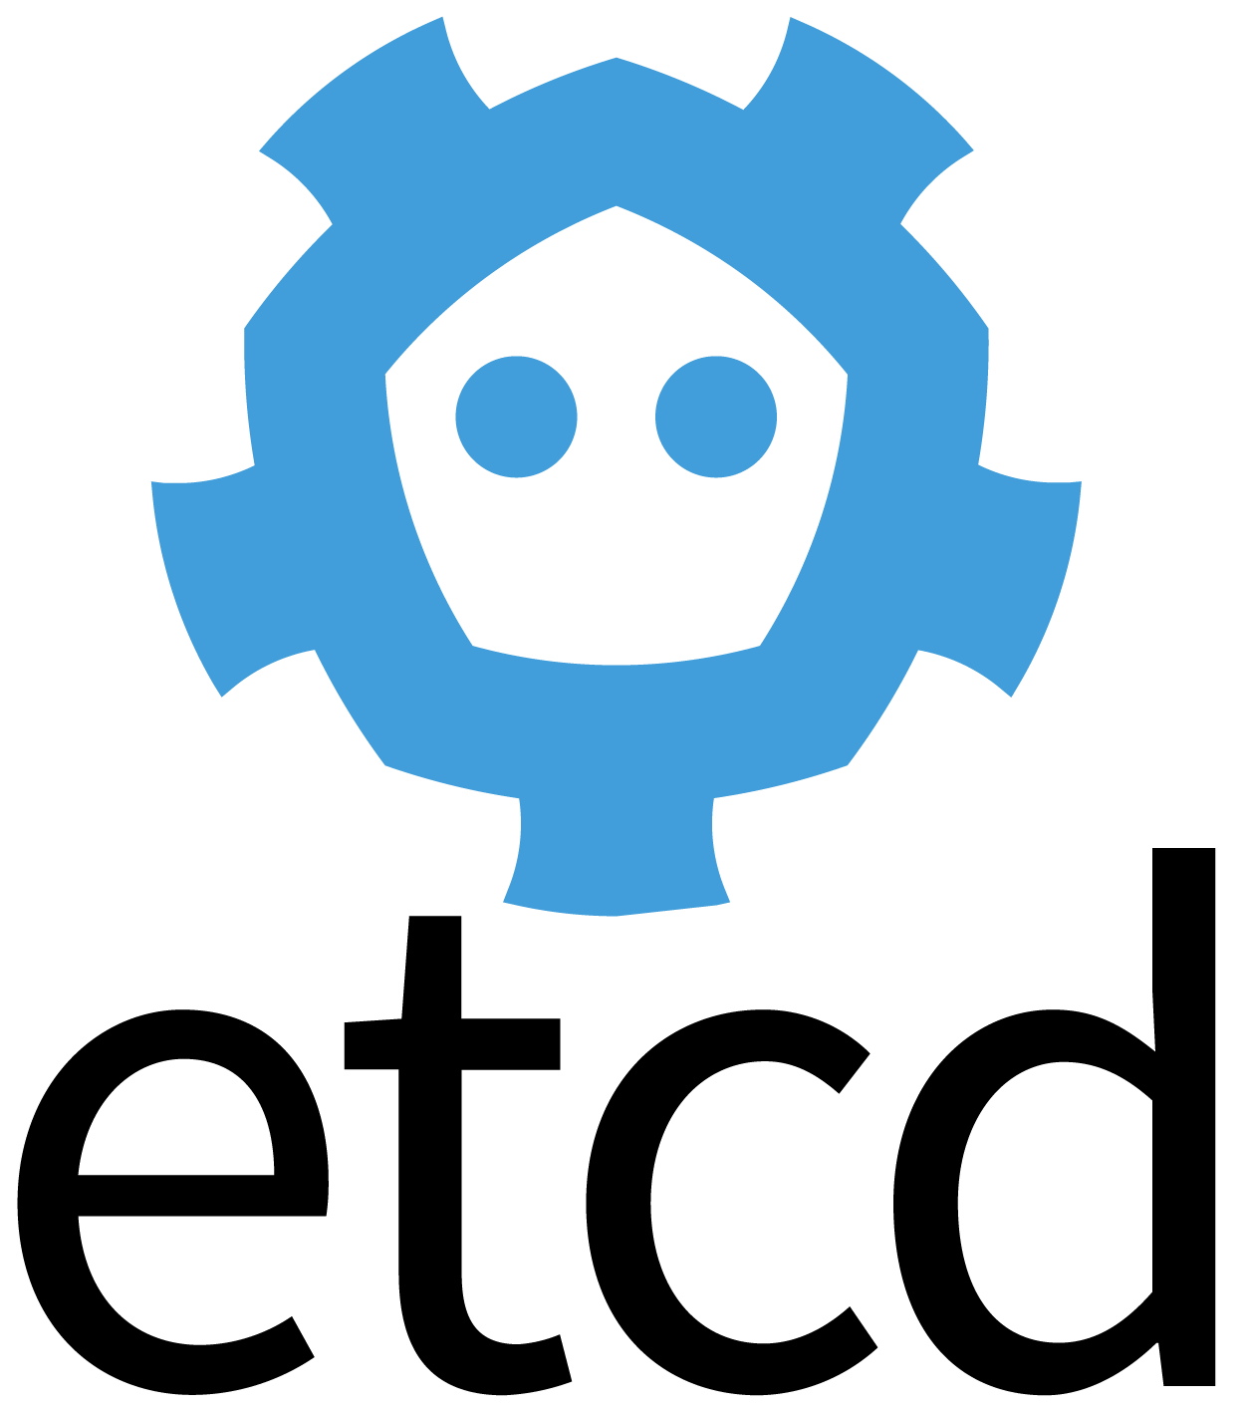




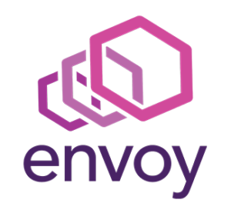
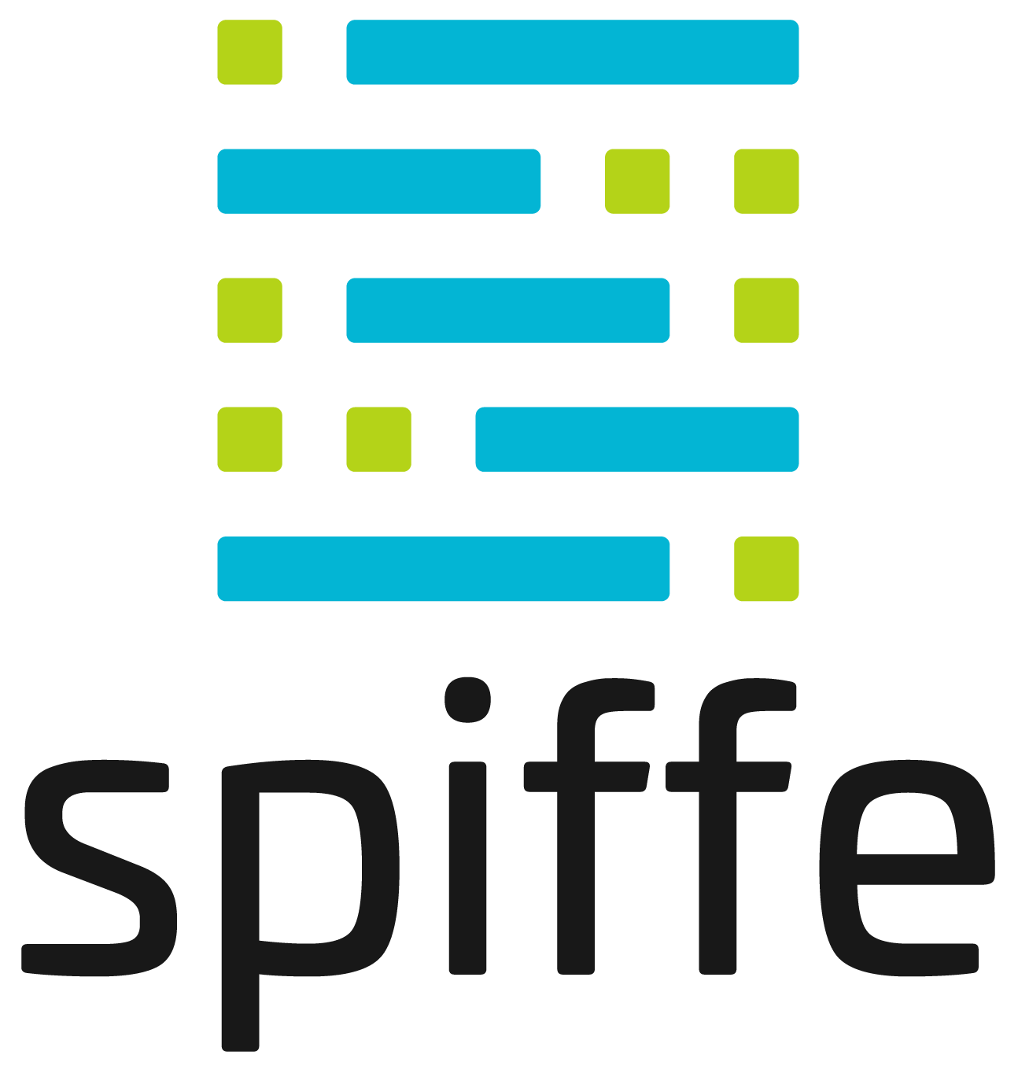
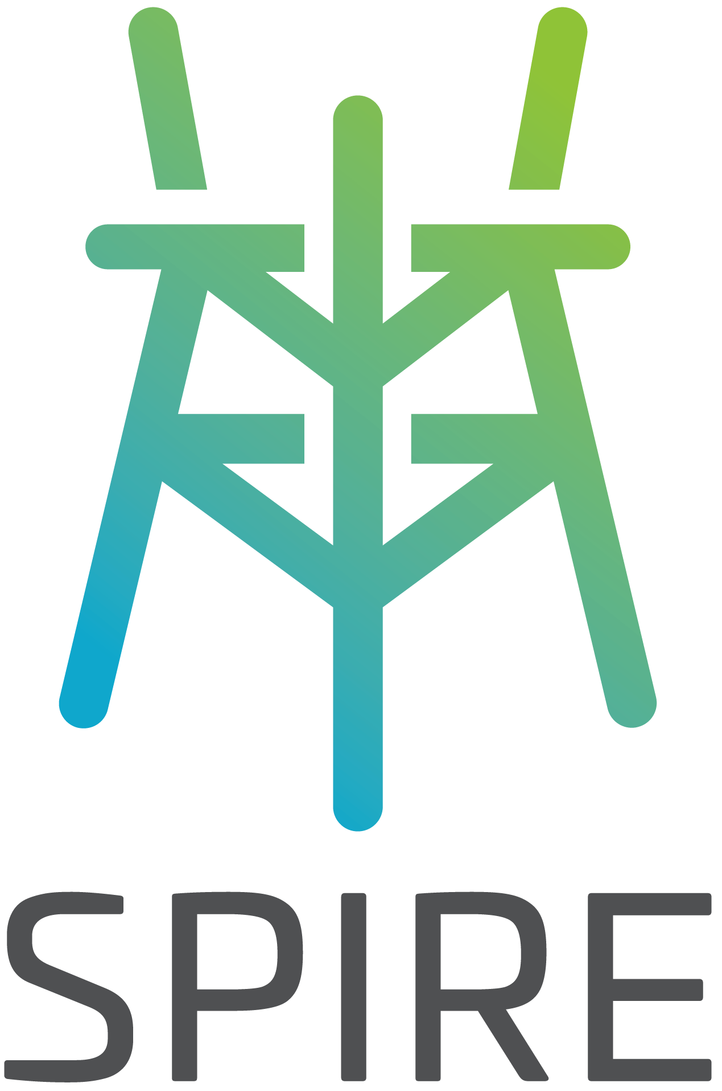

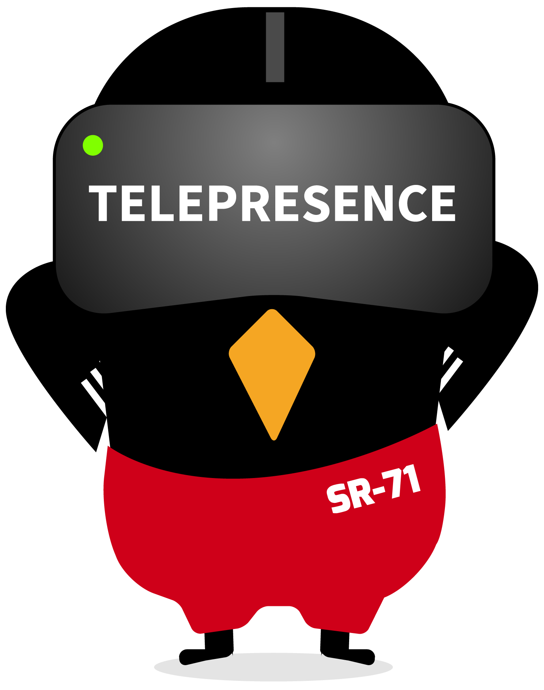

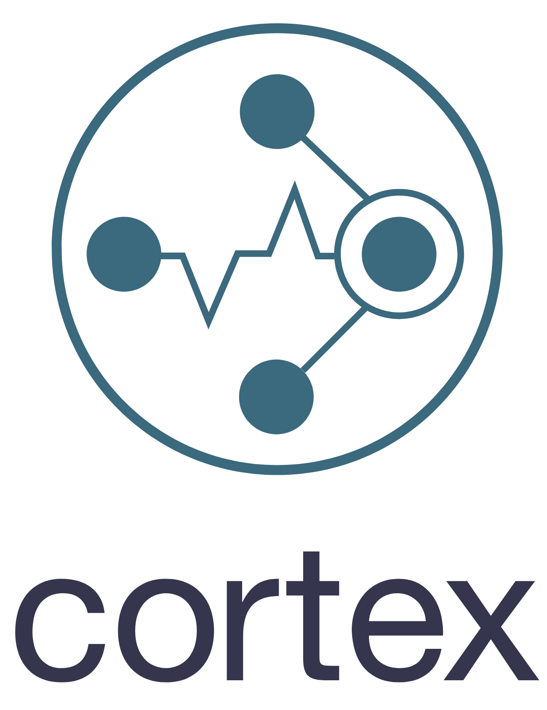


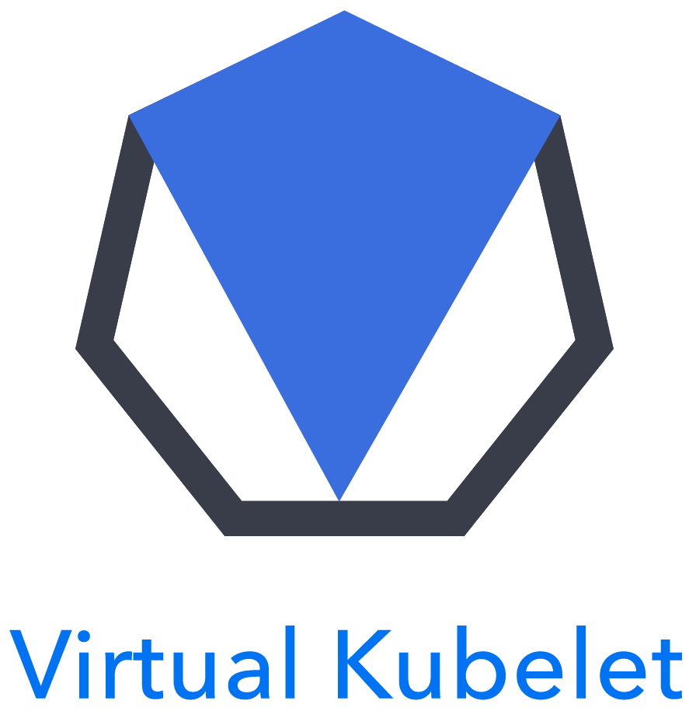

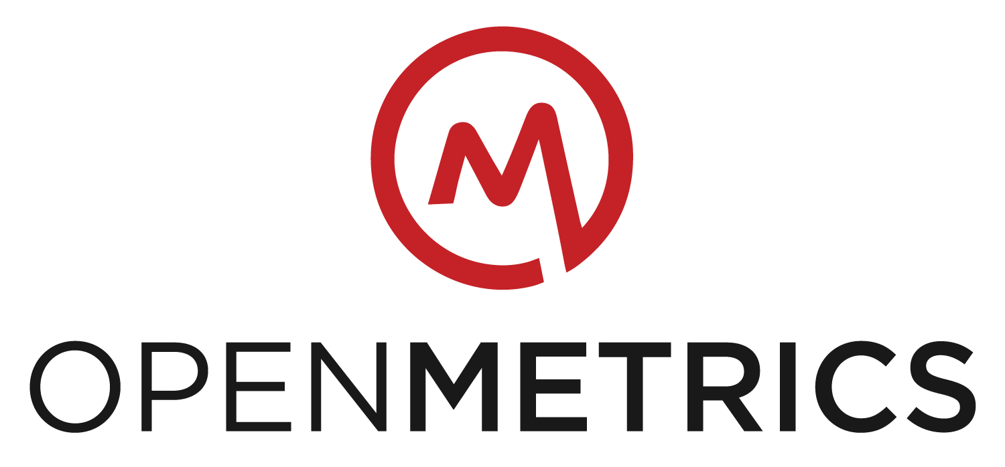
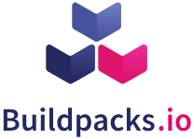
Goal: to target CNCF projects
Graduated
Incubating
Orchestration
Distributed Tracing API
Logging
Remote Procedure Call
Container Runtime
Container Runtime
Networking
API
Distributed Tracing
Software Update Spec
Monitoring
Security
Storage
Service Discovery
Messaging
Service Mesh
Package Management
Registry
Distributed K/V
Storage
Service Mesh
SANDBOX
Identity Spec
Identity
Policy
Serverless
Tooling
Metrics Spec
Distributed K/V
Monitoring
Packaging Spec
Container Security
Image Distribution
Nodeless
Notes:
As of Dec. 11, 2018, per https://www.cncf.io/projects/:
Starting with Graduated and Incubating Level Projects
Kubernetes, Prometheus, Fluentd, CoreDNS and Envoy have been added to cncf.ci

Slide 7

Cross-cloud CI Intro: cncf.ci
Notes:
https://twitter.com/TechJournalist/status/1072502470188904454
http://www.eweek.com/cloud/how-cncf-is-growing-the-cloud-landscape-at-kubecon
The CNCF ecosystem is large, diverse and continues to grow. CNCF would like to ensure cross-project interoperability and cross-cloud deployments of all cloud native technologies and show the daily status of builds and deployments on a status dashboard.

Slide 8

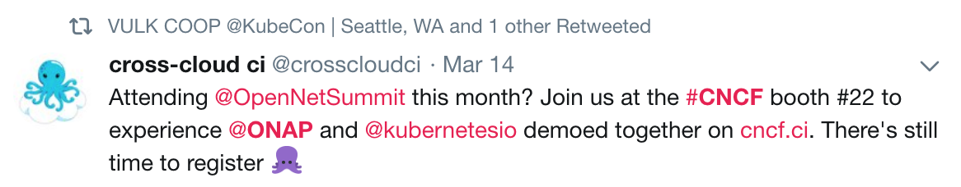
Goal: to target non-CNCF projects
Implemented
Notes:
https://twitter.com/crosscloudci/status/973934053664657408

Slide 9




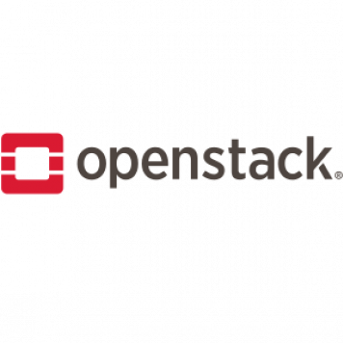
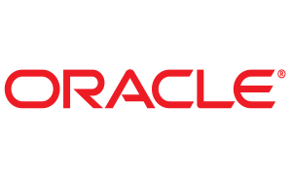
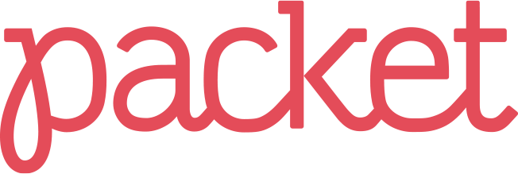

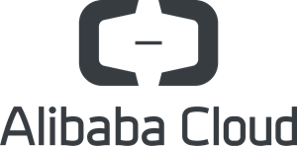


Goal: to target public, bare metal
& private clouds
+

Slide 10
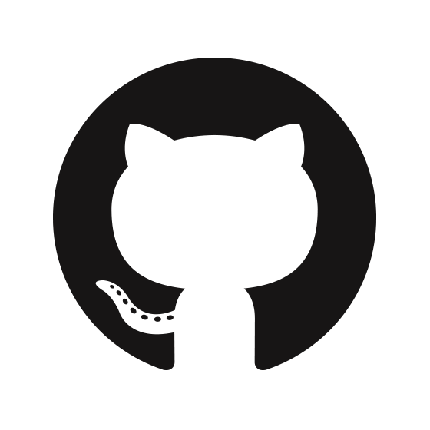
CNCF CI Platform started (Feb 28, 2017)
Feb 1st, 2017: CNCF CI Goals posted to mailing list
Feb 28, 2017: CI Platform started
CI Platform started
Feb 28

Slide 11



CI Dashboard Greenlight (Sept 22nd, 2017)
Greenlight to start implementation of CI Dashboard
Granted during Open Source Summit in Los Angeles
CI Platform started
1st demo of CI Platform
CI Platform v.1.0.0 Release
Greenlight
for
Dash-
board
Feb 28
June 27
Aug 13
Sept 22

Slide 12
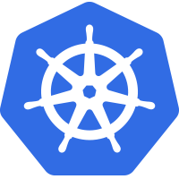
Cncf.ci v1.0.0 Release (Jan 26th, 2018)
Cncf.ci v1.0.0 released to production
Included the Dashboard, Status API server, 4 active projects and 5 active clouds
Projects: K8s, Prometheus, CoreDNS, Linkerd
Clouds: AWS, Azure, GCE, GKE, Packet
CI Platform started
1st demo of CI Platform
CI Platform v.1.0.0 Release
Greenlight
for
Dash-
board
Dash-
board v1.0.0 Release
Feb 28
June 27
Aug 13
Sept 22
Jan 26

Slide 13
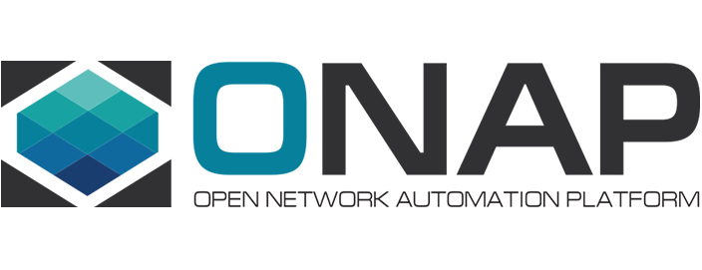

Cncf.ci v1.1+ Releases (March, 2018)
Cncf.ci v1.1.0 released
Added Fluentd and IBM Cloud
Cncf.ci v1.2.0 released
Added ONAP SO project
Cncf.ci v1.3.0 released
Added OpenStack
CI Platform started
1st demo of CI Platform
CI Platform v.1.0.0 Release
Greenlight
for
Dash-
board
Dash-
board v1.0.0 Release
Dash-
board v1.1.+
Releases
Feb 28
June 27
Aug 13
Sept 22
Jan 26
Mar 20

Slide 14
Cncf.ci v1.5.0 Release (Sept 7, 2018)
Cncf.ci v1.5.0 released to production
Added Envoy to projects
CI Platform started
1st demo of CI Platform
CI Platform v.1.0.0 Release
Greenlight
for
Dash-
board
Dash-
board v1.0.0 Release
Dash-
board v1.1.+
Releases
Dash-
board v1.5.0 Release
Feb 28
June 27
Aug 13
Sept 22
Jan 26
Mar 20
Sep 7

Slide 15
Cncf.ci v1.6.0 Release (Oct 31, 2018)
Cncf.ci v1.6.0 released to production
Added OCI to deployments
CI Platform started
1st demo of CI Platform
CI Platform v.1.0.0 Release
Greenlight
for
Dash-
board
Dash-
board v1.0.0 Release
Dash-
board v1.1.+
Releases
Dash-
board v1.5.0 Release
Dash-
board v1.6.0 Release
Feb 28
June 27
Aug 13
Sept 22
Jan 26
Mar 20
Sep 7
Oct 31
Notes:
https://github.com/crosscloudci/crosscloudci/wiki/Release-Notes:-Dashboard-v1.6.0
By Oct 2018 we added support for 8 cloud providers and 6 projects + K8s

Slide 16
CI Status Dashboard Overview
CI Dashboard Overview:
Overview of cncf.ci
Shows status of 3 pipeline stages: Build, Provision and App Deployments
Refreshes at 3:00am Eastern Time every day
Supports dynamically adding/removing active clouds and projects
Clicking on Build status badge opens CI system build job URL
Clicking on Release Name opens project’s GitHub commit URL
Clicking on Deployment status badge opens “provisioning/app-deploy” job URL

Slide 17
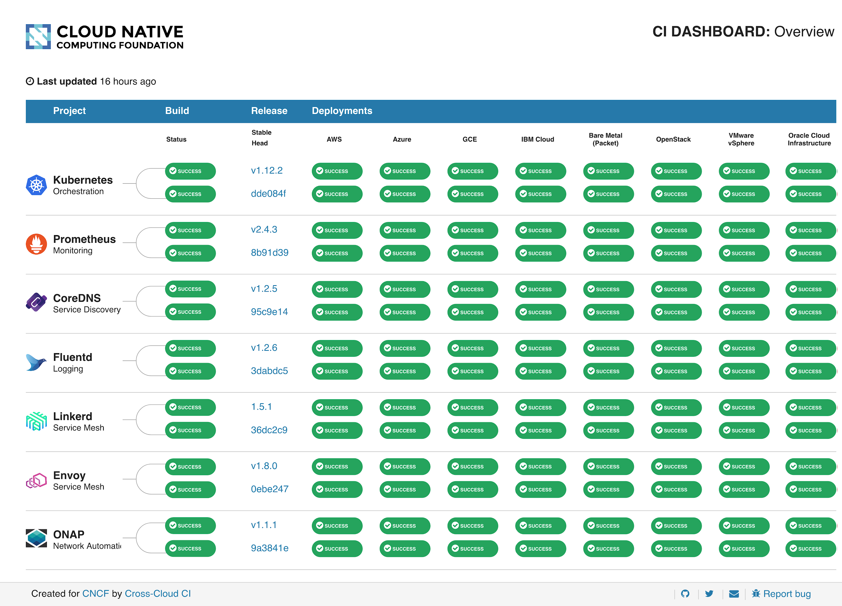
‹#›
Notes:
cncf.ci

Slide 18
1. Build projects from source
‹#›

Slide 19
1. Build projects from source
‹#›

Slide 20
2. Provision w/ cross-cloud
‹#›

Slide 21
3. Deploy w/ cross-project
‹#›

Slide 22
CI Status: Sometimes things fail
See dashboard snapshot
From Monday, December 10, 2018

Slide 23
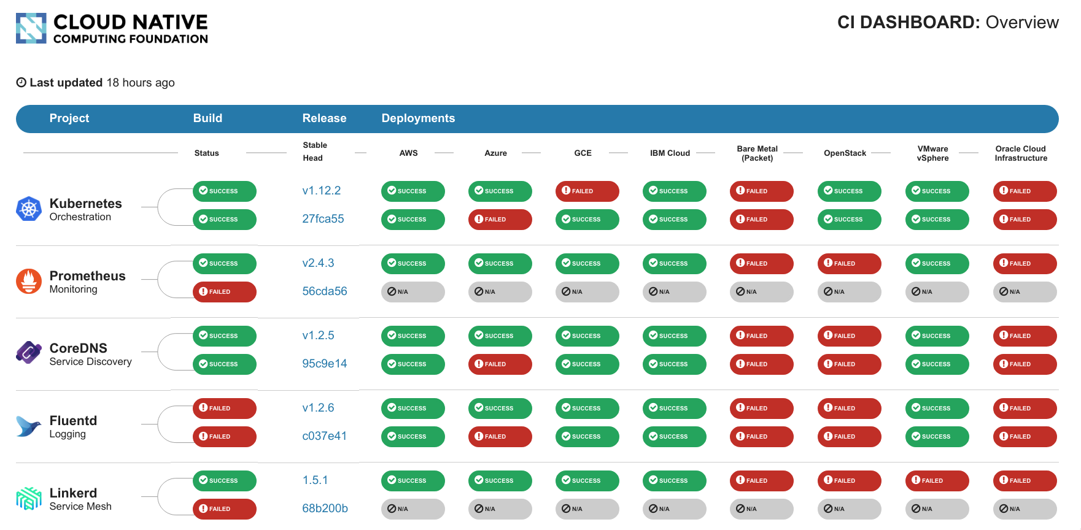
‹#›

Slide 24
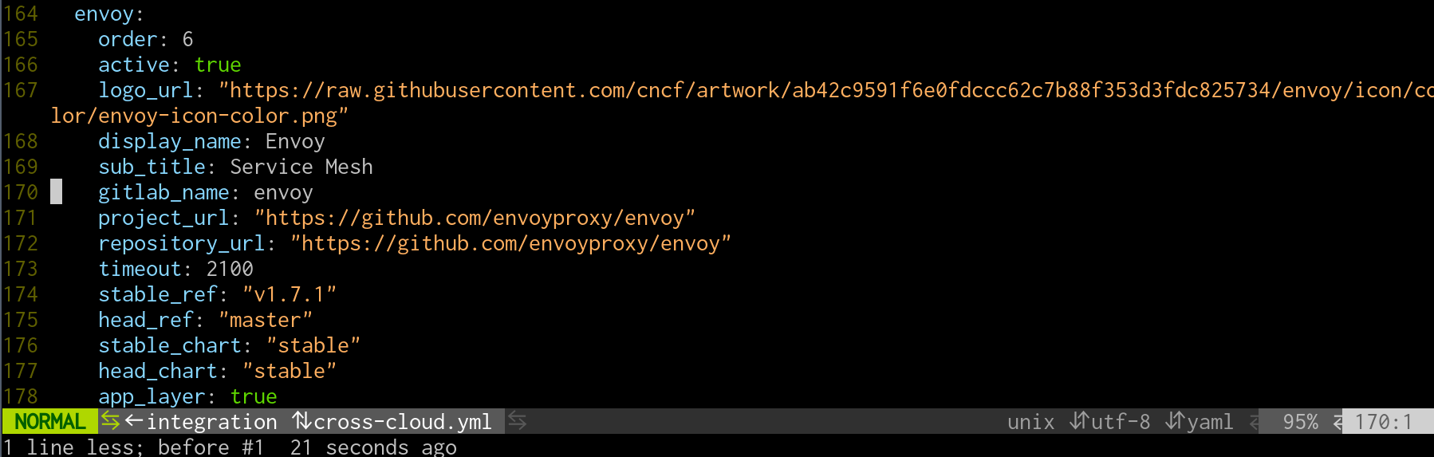
Project Configuration

Slide 25
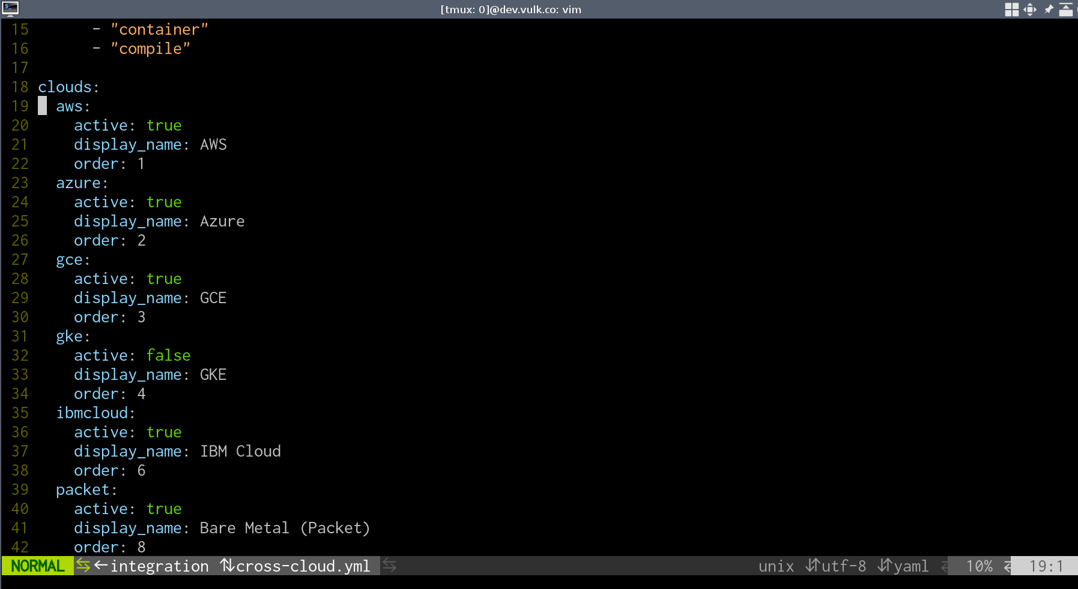
Cloud Configuration

Slide 26
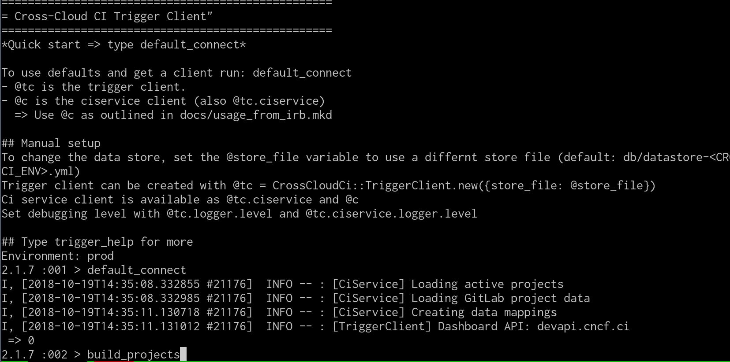
Refresh triggered

Slide 27
Testing System Overview
Build Pipeline per project (optional, can use project’s build artifacts)
Cloud Provisioning Pipeline (cross-cloud)
App Deployment Pipeline (cross-project)

Slide 28
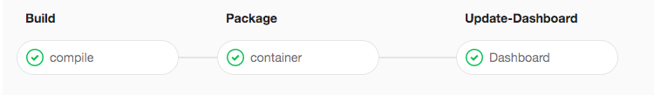
Build Pipeline Stage
Build: Compile binaries and e2e tests
Package: Create containers, create artifact pinning config and push to registry
Update-Dashboard: Update build status badges

Slide 29
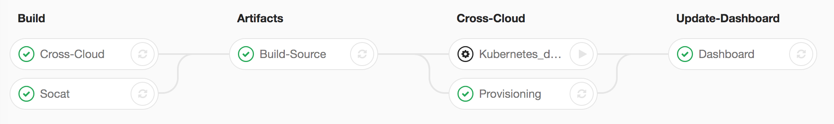
Cloud Provisioning Pipeline Stage
Build: Prepare provisioning software from the cross-cloud project
Artifacts: Collect K8s artifact pinnings from the previous K8s builds
Cross-Cloud: Deploy K8s onto each cloud using cross-cloud provisioner
Update-Dashboard: Update deployment badges

Slide 30
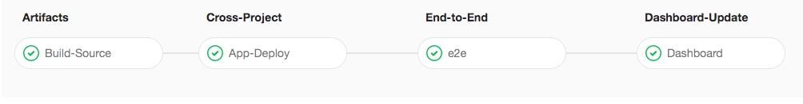
App Deployment Pipeline Stage
Artifacts: Collect project artifact pinnings from the previous build stages
Cross-Project: Use Helm charts to deploy each project
End-to-End: Run e2e tests for each project
Dashboard-Update: Update deployment status badges

Slide 31
Technology Overview

Slide 32
CI System Technology Overview
Unified CI/CD platform: GitLab
Cross-cloud provisioning: Terraform, Cloud-init, and per cloud K8s configuration
App deployments: K8s manifest management with Helm
E2e tests: Custom containers + Helm
Automated builds and deployments: Git + per project yaml configuration
Notes:
Provisioning: https://github.com/crosscloudci/cross-cloud
App-deployments: https://github.com/crosscloudci/cross-project

Slide 33
Dashboard Technology Overview
Frontend: Vue.js
Status repository: Elixir and Erlang
Automated builds and deployments: Git + per project yaml configuration
Notes:
Frontend: https://github.com/crosscloudci/ci-dashboard
Status Repo: https://github.com/crosscloudci/ci_status_repository

Slide 34
Lessons Learned

Slide 35
Lessons Learned
Starting with the end-user interface is advised
Serve one audience as your focus
Simplify what you are communicating
Graceful failures in the Web UI
Notes:
Add other screens for different audiences and status

Slide 36
‹#›
Notes:
Starting with the end-user interface is advised
Communicating too many things
What does the status really mean?
Graceful failures in the Web UI

Slide 37
Lessons Learned
Don’t start tightly coupled to an existing CI platform
API, pipeline, event hooks
Mixing CI for the software components with implementation
Supporting existing project CI systems

Slide 38
Lessons Learned
Design for projects and cloud providers to help from the start
The entire system should be reproducible by others
Support composable portions from the start (eg. kubeadm)

Slide 39
What’s Next?

Slide 40
What’s next for Cross-cloud CI?
Cross-Group Collaboration:
OpenCI community
OPNfv collaboration
Network Service Mesh collaboration
Gathering feedback from End Users, CNCF Projects and K8s Community on next iteration of cncf.ci Status Dashboard

Slide 41
What’s next for Cross-cloud CI?
Adding More CNCF Projects:
Jaeger
Notary
Vitess
etc

Slide 42
What’s next for Cross-cloud CI?
Adding New Features:
Automate project release updates
API for history of builds, deployments and end-to-end tests
Rollback to previous working release
Integrate with other test platforms
New screens TBD: Per Project, Per Deployment, etc

Slide 43
Upcoming Events
CNCF Cross-cloud CI Deep Dive at KubeCon North America 2018
Day: Wednesday, December 12
Time: 10:50am - 11:25am Pacific Time
Location: Tahoma 5 @ TCC The Conference Center (TCC)
CI WG Public Meetings
Day: 4th Tuesday of month
Time: 11:00am Pacific Time (US and Canada)
Location: https://zoom.us

Slide 44
How to Collaborate
Attend CI WG meetings:
https://github.com/cncf/wg-ci
Subscribe to the CNCF CI public mailing list:
https://lists.cncf.io/g/cncf-ci-public
Create issues on GitHub:
https://github.com/crosscloudci/crosscloudci/issues

Slide 45



Connect with the team
@crosscloudci
@crosscloudci
@vulkcoop
crosscloudci@vulk.coop

Slide 46
Q&A

Slide 47
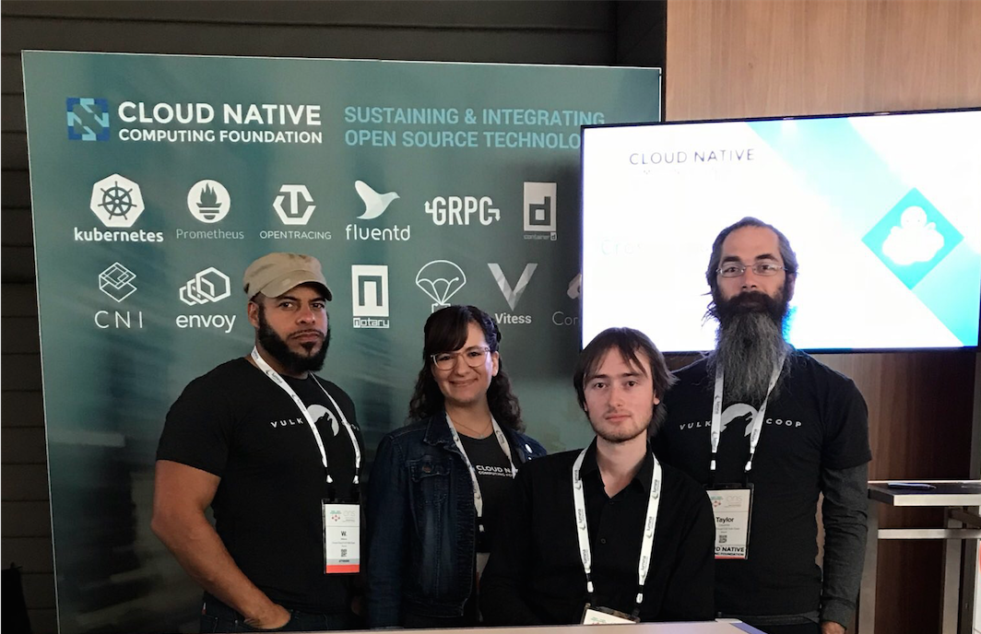
Thank you for your feedback!
W. Watson
@wavell
Lucina Stricko
@lixuna
Denver Williams
@denverwilliams
Taylor Carpenter
@taylor
Notes:
Today’s Presentation Prepared by:

Slide 48


